Slide 1
Principles of
data visualisation
Sophie Lee, PhD https://www.ncrm.ac.uk/resources/online/all/?id=20844

Slide 2
Why is data visualisation so important?
Visualisation is a part of each point in an analysis journey:
Exploring the data
Notes:
Data visualisation is one of the most important parts of any analysis journey. Visualisations can be used for many different purposes, such as:
Exploring the data,

Slide 3
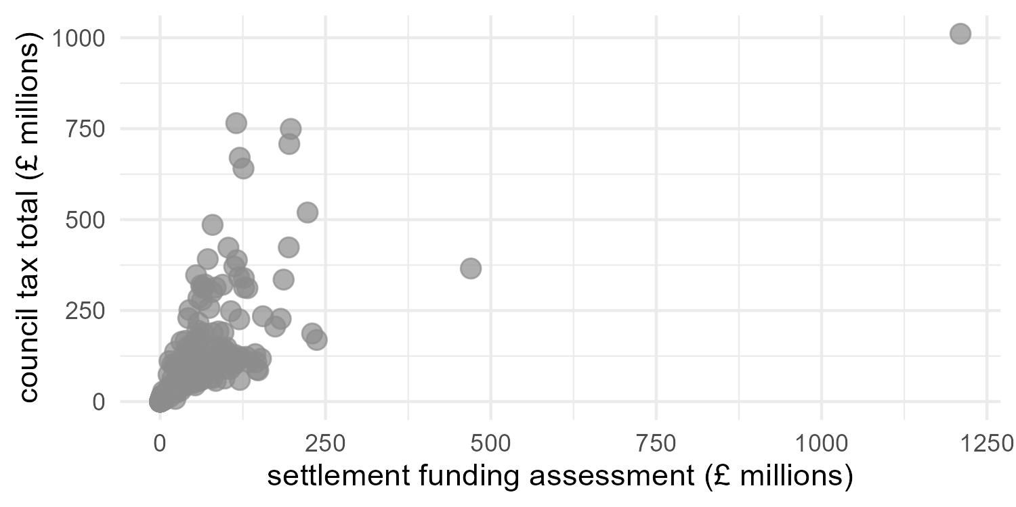
Notes:
Including identifying outliers

Slide 4
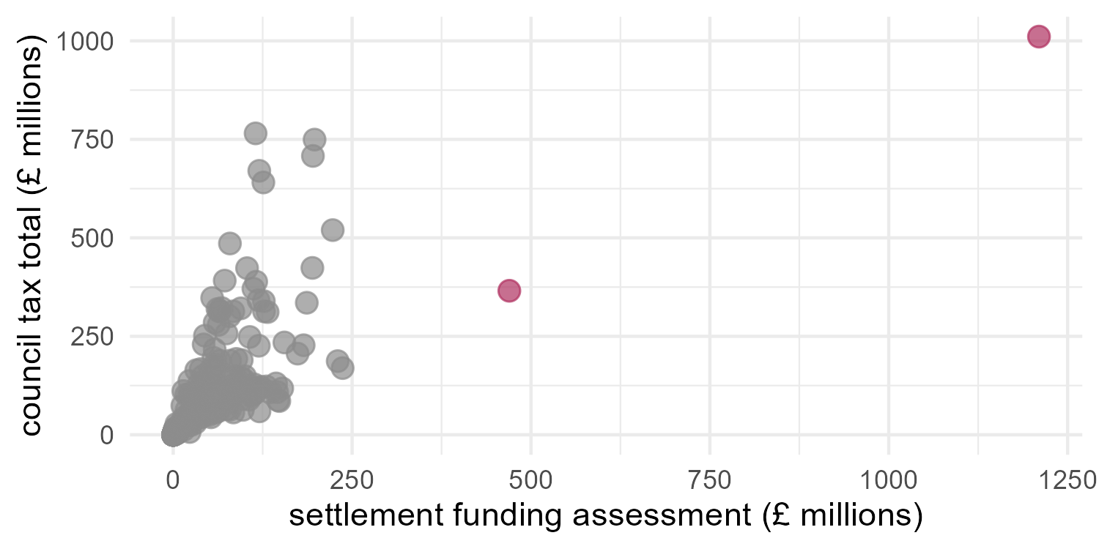
Notes:
That may be potential errors in the data

Slide 5
Why is data visualisation so important?
Visualisation is a part of each point in an analysis journey:
Exploring the data
Checking assumptions for parametric tests and models
Notes:
Checking assumptions for tests or models

Slide 6
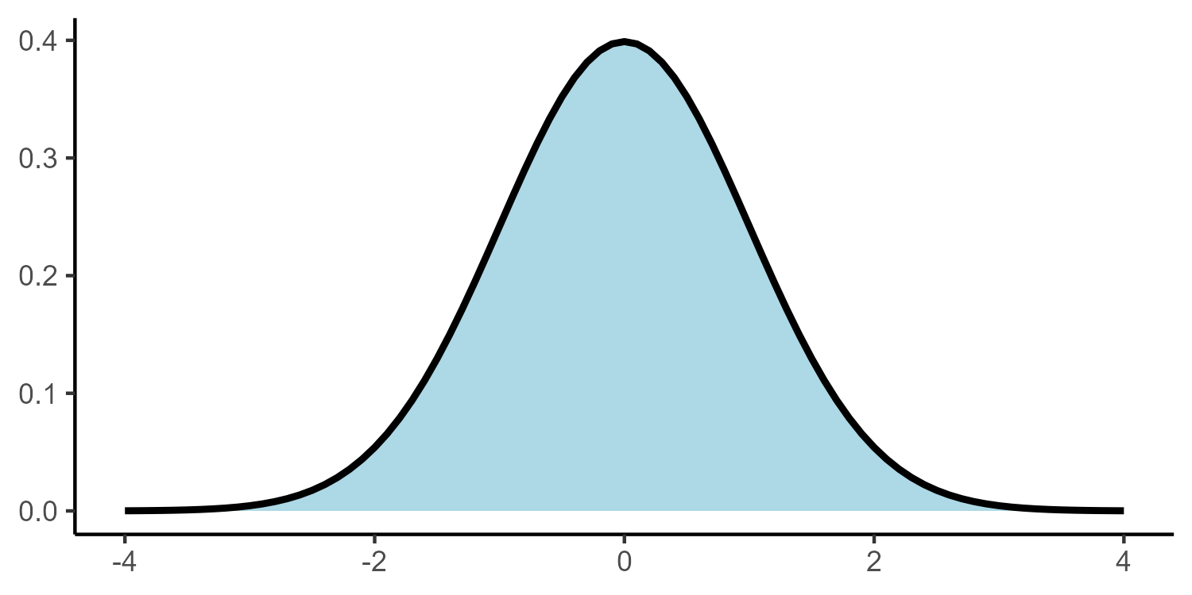
Notes:
A common assumption required for tests of numeric variables is the normal distribution

Slide 7
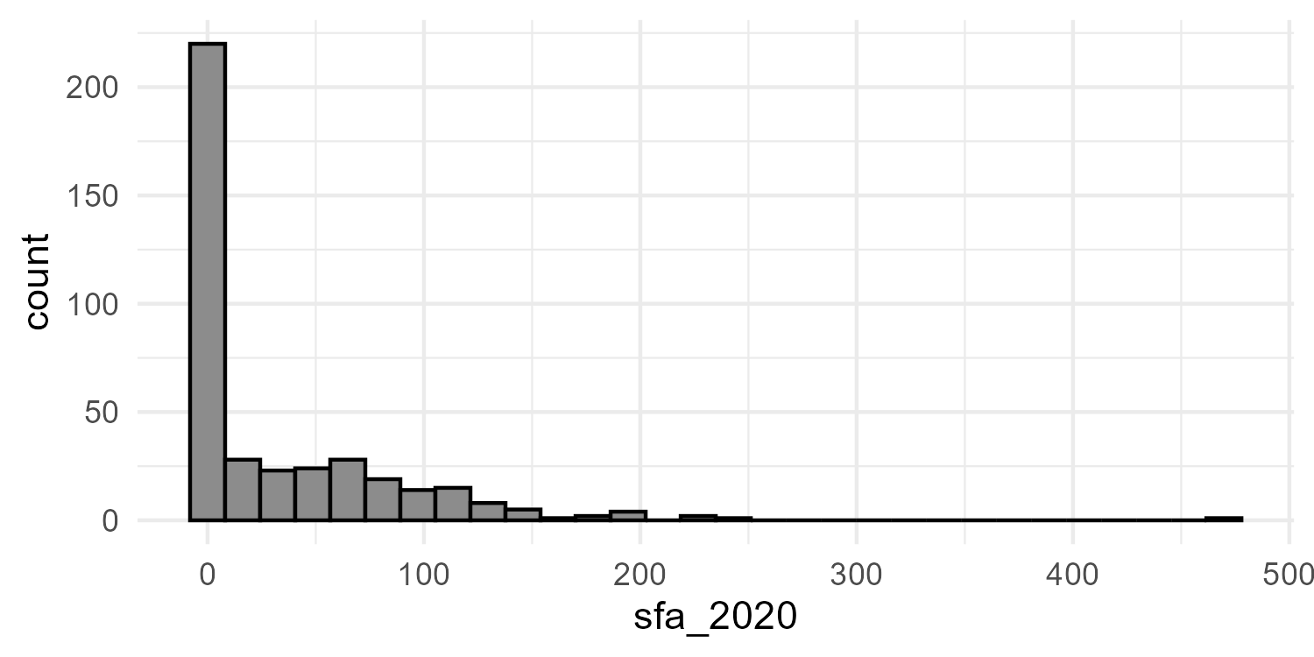
Notes:
Histograms can be used to check the shape of a variable and decide whether certain tests are valid

Slide 8
Why is data visualisation so important?
Visualisation is a part of each point in an analysis journey:
Exploring the data
Checking assumptions for parametric tests and models
Generating hypotheses about trends and relationships in the data
Notes:
Generating hypotheses about the data

Slide 9
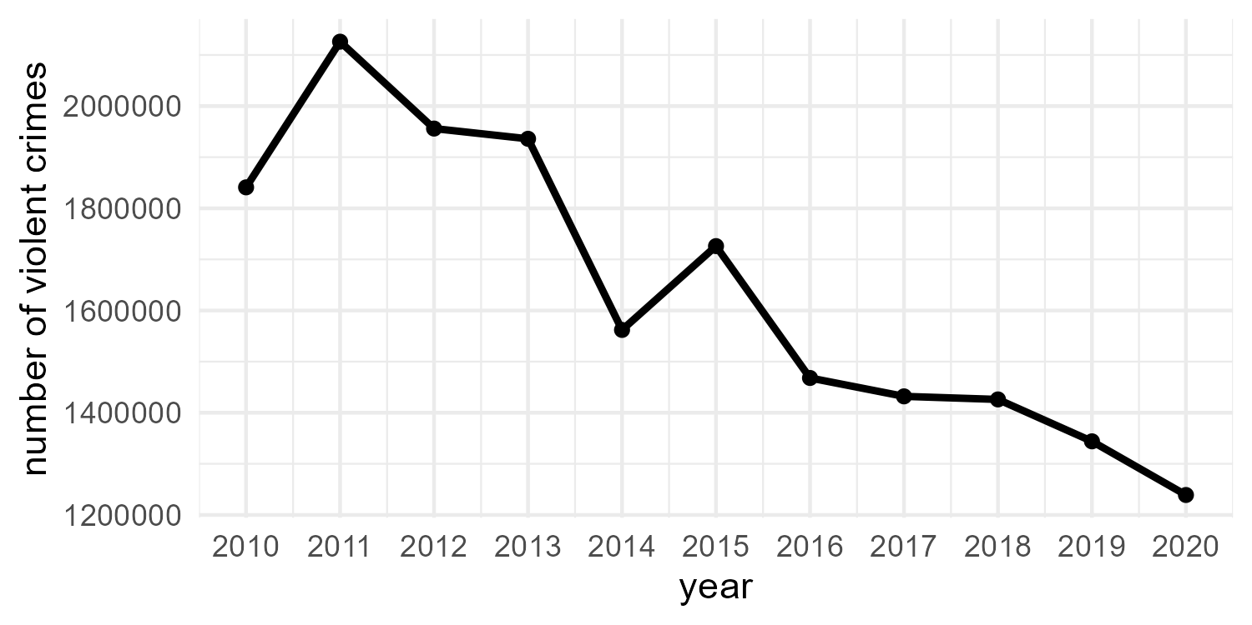
Notes:
Such as temporal trends or relationships between variables

Slide 10
Why is data visualisation so important?
Visualisation is a part of each point in an analysis journey:
Exploring the data
Checking assumptions for parametric tests and models
Generating hypotheses about trends and relationships in the data
Convey important results and messages in a clear, concise way
Notes:
And finally, they are able to convey important messages in a clear,concise way. Often in a more powerful way than simply adding text

Slide 11
What makes a ‘good’ data visualisation?
“Graphical excellence is the well-designed presentation of interesting data - a matter of substance, statistics and design” - Edward Tufte, The Visual Display of Quantitative information
How do we find the correct balance between these elements?
Notes:
Data visualisation is part art, part science. Tufte describes graphical excellence as a “matter of substance, statistics, and design”. Finding the balance of these elements can be a challenge.

Slide 12
Four key principles for good data visualisation
1. Show the data!
2. Choose an appropriate design
3. Ensure data integrity
4. Make the visualisation accessible
Notes:
To create compelling, informative data visualisations, we must adhere to four key principles:

Slide 13
Show the data!
Notes:
First, we must show the data

Slide 14
Show the data
Maximise the information in the smallest amount of space
Notes:
Show as much data as possible, maximising the amount of information given in the smallest amount of space.

Slide 15
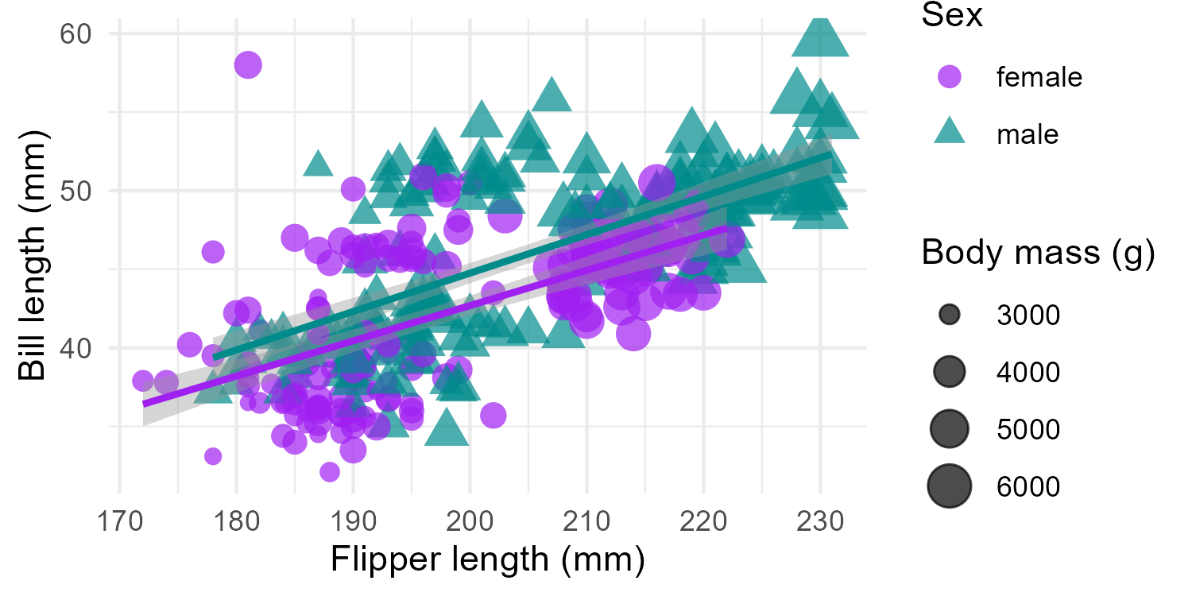
Notes:
This does not mean show all of the data. Overloading a plot can lead to confusion,

Slide 16
Show the data
Maximise the information in the smallest amount of space
Adding too much data can lead to confusion
Notes:
making it less informative than a simpler plot that shows less data clearly

Slide 17
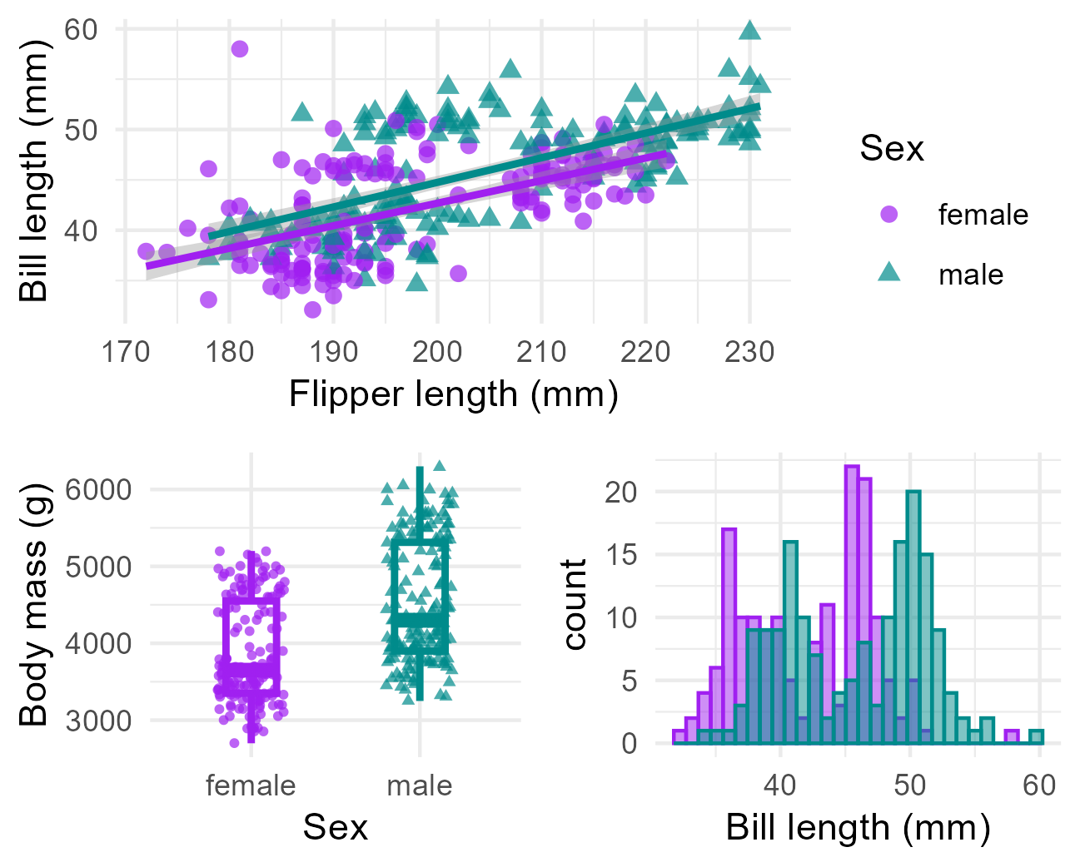
Notes:
Multiple, simpler graphs with a clear message is better than a single, confusing graph that hides the message we hope to impart

Slide 18
Show the data
Maximise the information in the smallest amount of space
Adding too much data can lead to confusion
Choose the most appropriate data to achieve the visualisation’s goal!
Notes:
Have a clear goal in mind of what you would like readers to gain from your visualisation and choose the most appropriate data to do so.

Slide 19
Choose an appropriate design
Notes:
The second principle of good data visualisation is to choose an appropriate design

Slide 20
Visualisation design
Choice of visualisation should be decided by the context, the audience, and the goal of the graphic
Choice of visualisation will also depend on the type and number of variable we wish to show
Check out https://www.data-to-viz.com/ for visualisation choices based on variable type
Notes:
The choice of visualisation should be driven first and foremost by the context, the audience, and the goal of the graphic. This decision is also driven by the number and type of variables available. The From data to viz website4 is a great resource that gives a list of visualisations that are appropriate for each variable type and combination.

Slide 21
Visualisation design
Reduce the amount of chartjunk:
Unnecessary colours
Overbearing gridlines
Distracting patterns
BUT do not sacrifice context for minimalism
Notes:
Remove unnecessary clutter and design choices that do not enhance the intended message of the visualisation. This includes unnecessary colours and grid markings that may distract from the data.
However, do not allow the pursuit of a minimalist design detract from interpretation.

Slide 22
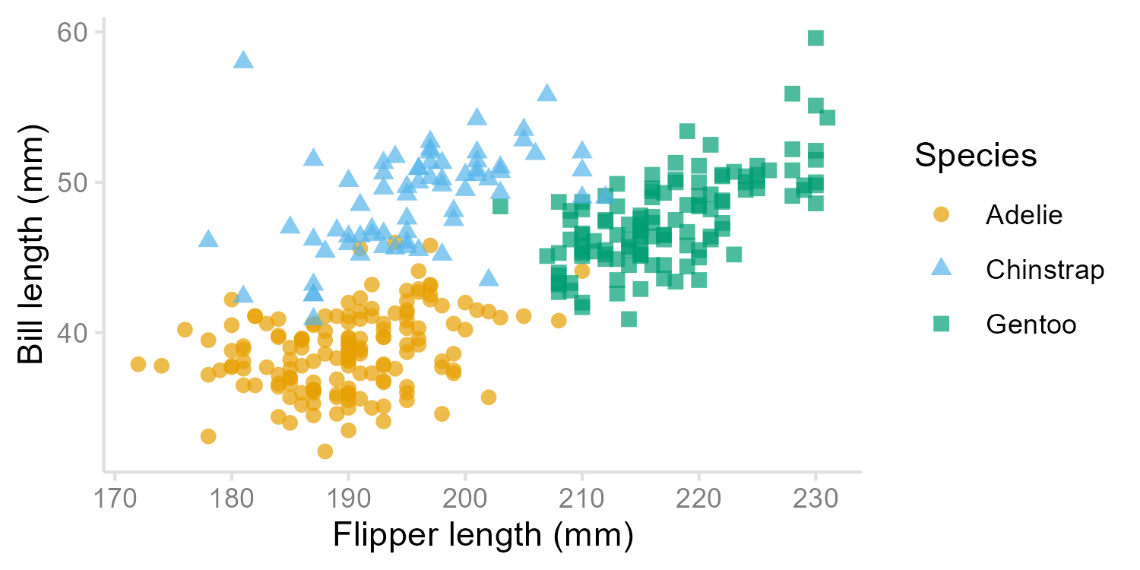
Notes:
For example, grid lines on a scatterplot can make values of points easier to read than if they are floating in space.
Good visualisation design requires a middle ground that ensures the data are the most important part of the graphic, whilst ensuring there is sufficient context.

Slide 23
Ensure data integrity

Slide 24
Data integrity
Do not distort the data in any way!
The visual representation of data is consistent with the numerical representation
Be aware of how perceptions may alter the interpretation of a visualisation
Notes:
Data visualisations must not distort the data, nor mislead the reader.
To achieve this, we must ensure that the visual representation of data is consistent with the numerical representation.
One of the main obstacles of achieving this is that people perceive things differently, depending on their experience and the context3. We must be mindful of where these perceptions may interfere with the interpretation of a visualisation For example, research shows that people’s perception of dots, lines and bars are more accurate than distinguishing between angles, proportions, and colour hues.

Slide 25
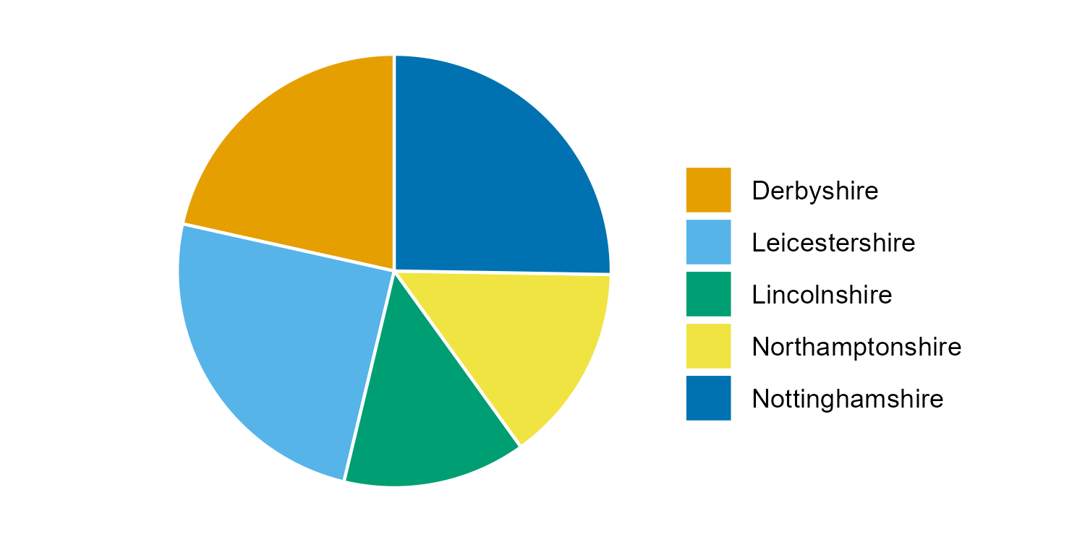
Notes:
Pie charts are an example of where differences in perception can be a challenge. The proportion of crimes recorded in Derbyshire, Leicestershire and Nottinghamshire, and the proportion recorded in Lincolnshire and Northamptonshire, are very similar. This makes it hard to identify differences between areas or make inferences about the highest (or lowest) levels of crime in the region.

Slide 26
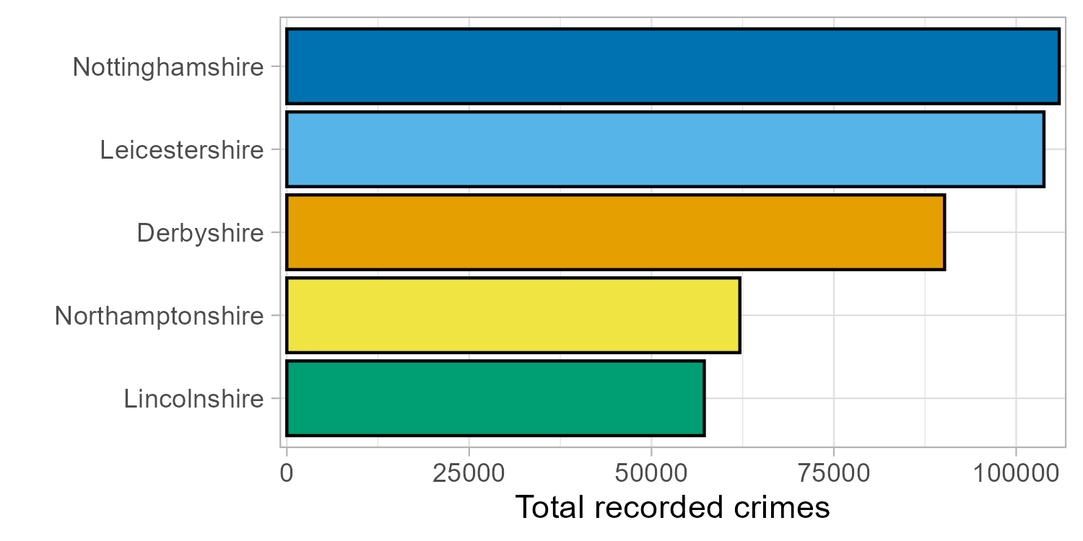
Notes:
A bar chart makes the differences between areas easier to interpret, particularly if we order the bars by length.

Slide 27
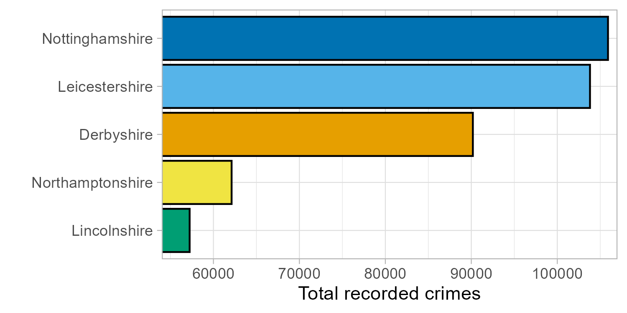
Notes:
Be careful to ensure that the amount of ink used in a visualisation is proportional to the quantities that it represents. A common violation of this is where plot axes do not begin at 0, leading to a distortion in the message. Here, this exaggerates the differences between groups, making the number of crimes in Lincolnshire and Northamptonshire look far smaller than they actually were

Slide 28
Make the visualisation accessible
Notes:
Finally, visualisations should be accessible.

Slide 29
Accessibility
All aspects of a visualisation must be interpretable and accessible
Ensure design choices are inclusive
Notes:
Visualisations are useless if they are inaccessible and uninterpretable. We must ensure all design choices are inclusive. Some considerations we can make to ensure this, include

Slide 30
Accessibility: text
Make text large enough to be legible
At least 12pt when printed, 36pt for presentations
Choose an inclusive font that is accessible for visual impairment and learning difficulties
Arial and Verdana are often cited as accessible fonts
Notes:
Ensuring text is legible. This means that it is large enough to be read and using a font size that is accessible to everyone, including those with visual impairments and learning difficulties.
Guidelines suggest text should be at least size 12 when plots are printed, e.g. in reports, and 36 where they are included in a presentation. There are specialist fonts designed to aid people with visual impairments but Arial and Verdana are free fonts that are regularly cited as inclusive

Slide 31
Inclusive colours
Choose colour palettes where each colour is distinct, including to those with colour-vision deficiencies
Check palettes using a colour-blindness simulator
Notes:
Colour palettes should be chosen based on the type of data they represent. Each colour should be distinct to everyone, including those with colour-vision deficiency

Slide 32
From Fundamentals of Data Visualization, Claus O. Wilke
Notes:
. A colour blindness simulator7 shows what a visualisation looks like under different types of colour blindness. Some colours are no longer distinct to people with certain colour vision deficiencies

Slide 33
Inclusive colours
Choose colour palettes where each colour is distinct, including to those with colour-vision deficiencies
Check palettes using a colour-blindness simulator
Avoid cyclical palettes like rainbow colours
Notes:
Avoid colour palettes that are cyclical, such as rainbow colours

Slide 34
Notes:
Each end merges into one another, making it difficult to distinguish between very high and very low values

Slide 35
Inclusive colours
Choose colour palettes where each colour is distinct, including to those with colour-vision deficiencies
Check palettes using a colour-blindness simulator
Avoid cyclical palettes like rainbow colours
Ensure colour choices make sense, e.g. blue for cold, red for hot and not the other way around
Avoid stereotypes such as pink for female and blue for male
Notes:
Avoid colour schemes that include stereotypes, such as pink for female, blue for male.

Slide 36
Reproducibility
Where appropriate, ensure data and code used to create visualisations is available and open
Consider using free repositories, e.g. Github, to host this
Notes:
As with all science, visualisations should be reproducible. Where possible, all data and code used to create visualisations should be open. Consider hosting this on a free repository, such as Github

Slide 37
www.ncrm.ac.uk

